Slide 1
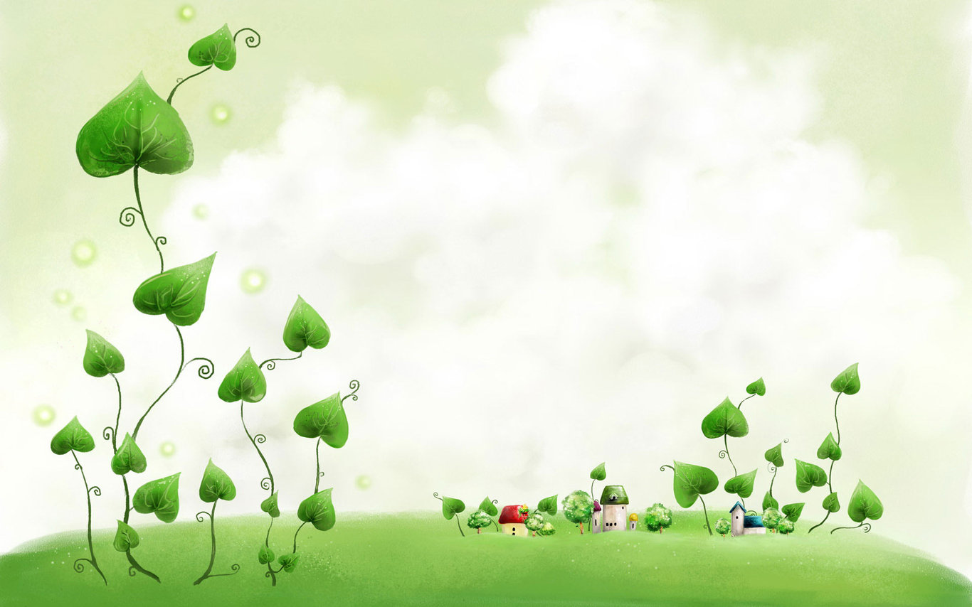


Monday, November 8th 2021
UNIT 4 MUSIC AND ART
Period 24
GETTING STATED
Notes:
1

Slide 2

Do you often listen to music? When? How often?
What kind of music do you like? Why?
What is art/ are arts?
* Art: the use of the imagination to express ideas or feelings, particularly in painting, drawing or sculpture.
* the arts ( in general): art, music, theater, literature, etc…When you think of them as a group.

Slide 3
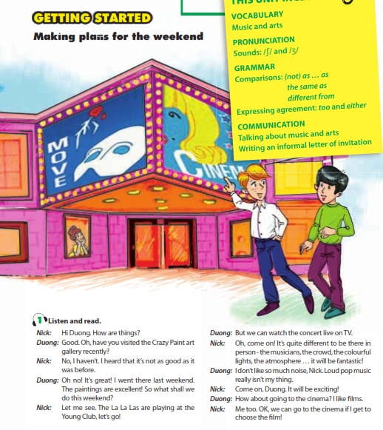

Slide 4
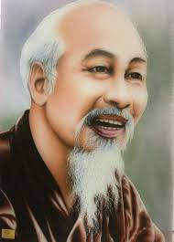
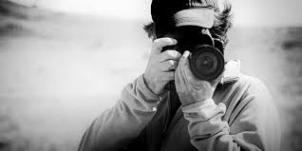
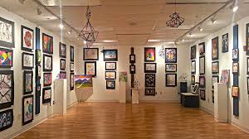
i. VOCABULARY
1. art gallery (n )
: phòng tranh
2. photography (n)
: nhiếp ảnh
3. portrait (n)
: chân dung
4. dedicate (v)
: Cống hiến
5. live on TV(v) = in person
: truyền hình trực tiếp
Ex: There is a football match live on TV tonight.

Slide 5
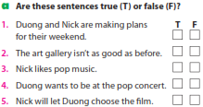
✓
✓
✓
✓
✓

Slide 6
Adjs | comparative | Superlative | equation
tall | taller than | the tallest | as tall as
short | shorter than | the shortest | as short as
I heard that it’s not as good as it was before.

Slide 7
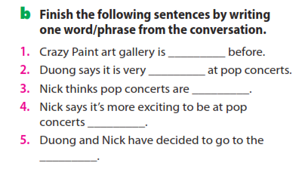
as good as
loud
fantastic
in person
cinema

Slide 8
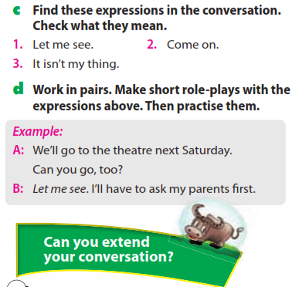

Slide 9
1. Let me see:
used when you are thinking what to say or reply.
2. Come on:
to show that you don’t agree with what somebody has said.
3. It isn’t my thing:
to show that you don’t like something.

Slide 10
Example 1
A: We’ll go to the theatre next Saturday. Can you go, too?
B: Let me see. I’ll have to ask my parents first.
Example 2
S1: Let’s go to the ballet tonight?
S2: Ballet seems boring to me. It isn’t my thing. I prefer something more interesting.
Example 3
S1: I am going to stay home tonight. I feel so bored. I don’t want to do anything.
S2: Oh, no. Come on! There’s a good film on at Sao Mai theater. Let’s go and enjoy it.
Example 4
S1: I like watching football match on TV.
S2: Oh, come on ! It’s more exciting to watch it at
the stadium.

Slide 11
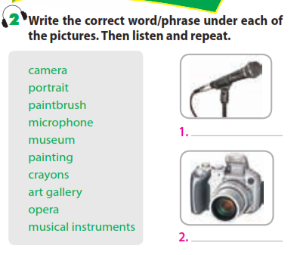

Slide 12
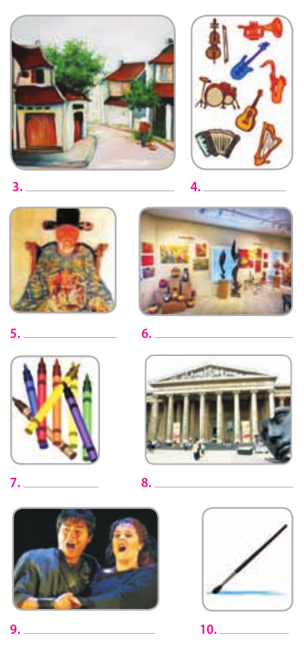

Slide 13
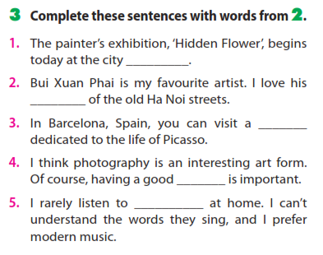
art gallery
paintings
museum
camera
opera

Slide 14
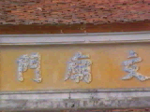
HOMEWORK
- Learn new words by heart.
- Practice the dialogue again.
- Do exercises B1, B2 (page 29/ workbook).
- Prepare for Unit 4: Closer look 1.
+

Slide 15




The bye bye song
Bye, bye.
See you tomorrow.
Bye, bye.
See you tomorrow.
Bye, bye.
See you tomorrow.
Bye, bye. Bye, bye.
The bye bye
song
Notes:
15

